Slide 1



Weather Forecasting for Power Prediction
This presentation explores using AI to forecast weather. It also focuses on predicting renewable energy power output. Our goal is optimizing energy systems. This ensures better grid stability and efficiency.
ADITH P – CB.EN.U4ELC22002
HARIKRISHNAN MIRAJ – CB.EN.U4ELC22014
MONISH KIRAN – CB.EN.U4ELC22032
SAKET RAM – CB.EN.U4ELC22048

Slide 2

Introduction: The Convergence of Weather and Power
Weather patterns and power demand are closely linked. Traditional forecasting methods struggle with weather-related power fluctuations. AI plays a transformative role. It enhances the accuracy and reliability of power predictions. AI is key for future energy grids.
Weather Patterns
Traditional Methods
Directly affects power demand
Limitations capturing fluctuations
AI Enhancements
Improves accuracy and reliability

Slide 3

Abstract
Renewable energy sources such as wind and solar power are highly dependent on weather conditions, making accurate forecasting crucial for optimizing energy generation and grid management. This project employs machine learning techniques, including Long Short-Term Memory (LSTM), Gated Recurrent Unit (GRU), and XGBoost models, to predict power generation based on weather parameters like temperature, wind speed, solar radiation, and humidity. The LSTM and GRU models, designed for time series forecasting, capture temporal dependencies in energy generation, while the XGBoost model provides robust predictive capabilities. By integrating weather forecasting with power prediction, this approach enhances grid stability, minimizes energy wastage, and supports efficient energy management in renewable energy systems. The proposed solution aims to provide real-time, data-driven insights to improve the reliability and efficiency of power generation.

Slide 4
Problem Statement
Accurate weather forecasting is essential for predicting the availability and efficiency of renewable energy sources like wind and solar power. This project aims to leverage AI techniques to forecast weather conditions and predict power generation in renewable energy systems. By analyzing key weather data (e.g., temperature, wind speed, barometer, humidity), machine learning models will provide real-time power output estimates. This integration will help optimize energy management, improve grid stability, and minimize energy waste, ensuring a more reliable and efficient power supply.

Slide 5
The Challenge: Renewable Energy Variability
Weather Dependent
Forecasting is Key
Renewable energy sources depend on weather. Solar and wind are most impacted.
Accurate weather data predicts power output.
This is essential for managing energy supply.
Fluctuations
Weather variations cause grid instability.
For example, cloud cover reduces solar power output by 70%.

Slide 6

Data Acquisition and Preprocessing
Key Weather Parameters
Key Power Parameters
Temperature
Elec_kW
Weather Condition
Wind Speed
Humidity
Barometer
Preprocessing
Cleaning
Normalization
Feature engineering
We normalize temperature data to a 0-1 scale. This ensures consistent model input.

Slide 7




Machine Learning Models
XGBoost
LSTM
GRU
Efficient, accurate gradient boosting.
Captures time dependencies effectively.
Another RNN for temporal data.
We tune hyperparameters using Grid Search. Bayesian Optimization is also helpful.

Slide 8

Power Prediction Modeling
Weather to Power
Data Merging
We map forecasts to energy generation.
We combine weather and power data.
Model Training
We use supervised learning with historical data.
For example, wind speed forecasts predict turbine output.

Slide 9





Model Evaluation Metrics
Precision
Accuracy of positive predictions.
Recall
Ability to find relevant cases.
Accuracy
Overall correctness of the model.
F1-Score
Balances precision and recall.
We also use a confusion matrix to show performance.

Slide 10
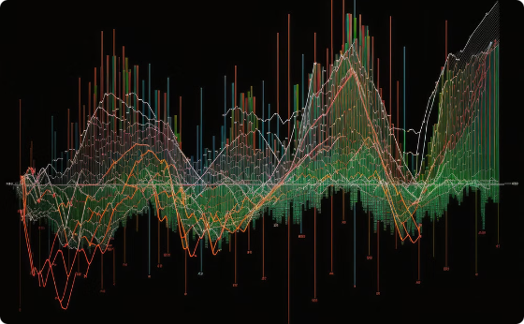
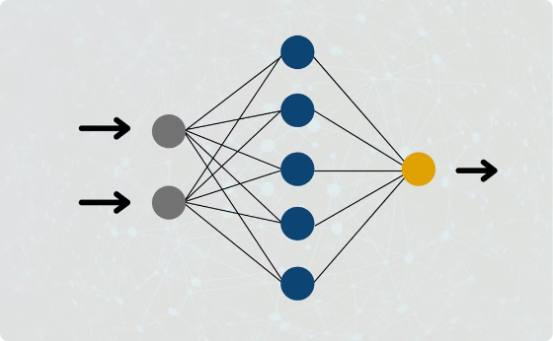

LSTM
Key components of the LSTM model for time series forecasting
Sequential Input
LSTM Layers with Dropout
Optimization
Accepts sequential input of power consumption and weather features, structured as a 3D tensor (samples, time steps, features).
Features two LSTM layers, each with 50 units, followed by dropout layers with a 0.2 dropout rate.
Employs the Adam optimizer with a learning rate of 0.001 and a mean squared error loss function for efficient learning.
Training Process
Validation
Tuning
We iteratively train the LSTM model on the merged data to optimize performance and make accurate predictions.
We evaluate the model's performance using validation datasets to ensure it generalizes well to unseen data.
Fine-tuning hyperparameters and adjusting the model architecture is crucial to enhance forecasting accuracy.

Slide 11

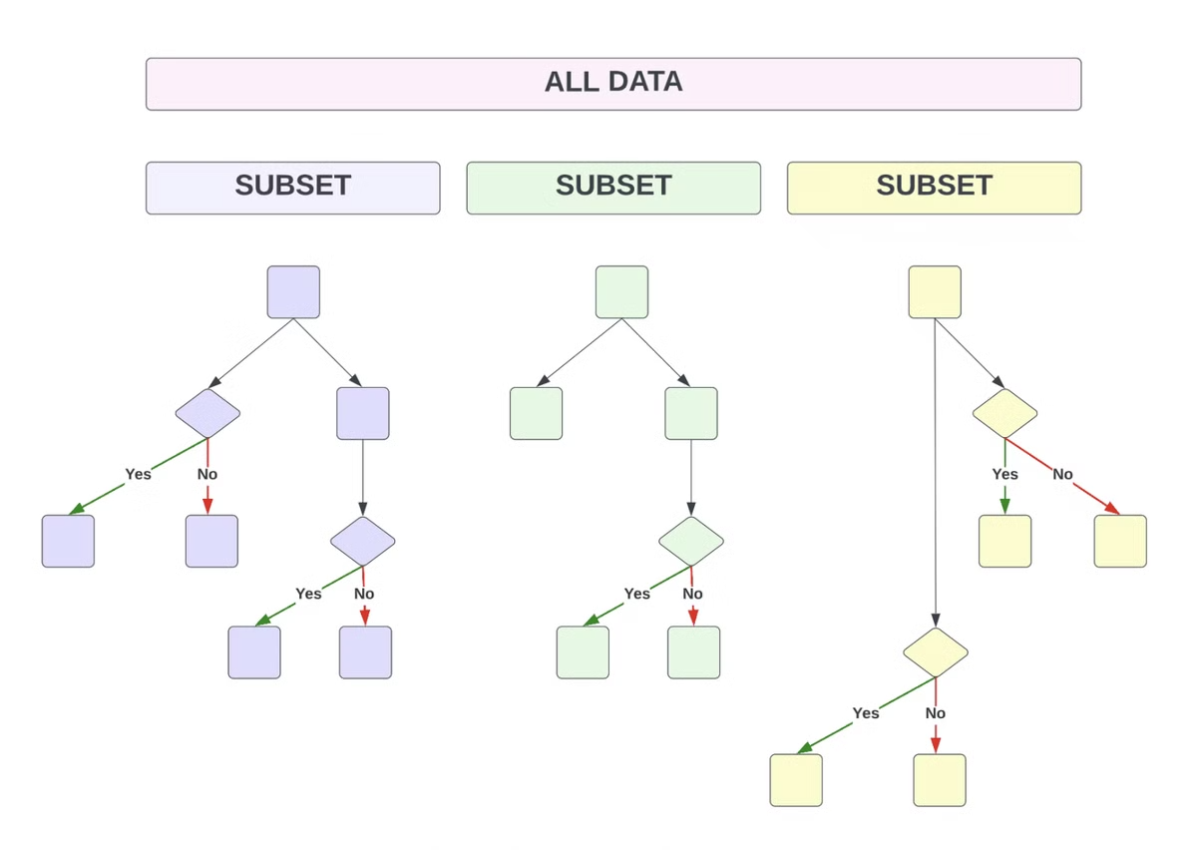
XGBoost
Feature Extraction
Model Training
Extract weather features (temperature, wind speed, humidity) and lagged power consumption values to use as input for the XGBoost model.
Train the XGBoost model using hyperparameter tuning to optimize its performance for power prediction.
Performance Evaluation
Evaluate the model's performance using MAE (Mean Absolute Error), Accuracy, and F1 Score to ensure accurate power consumption forecasting.

Slide 12

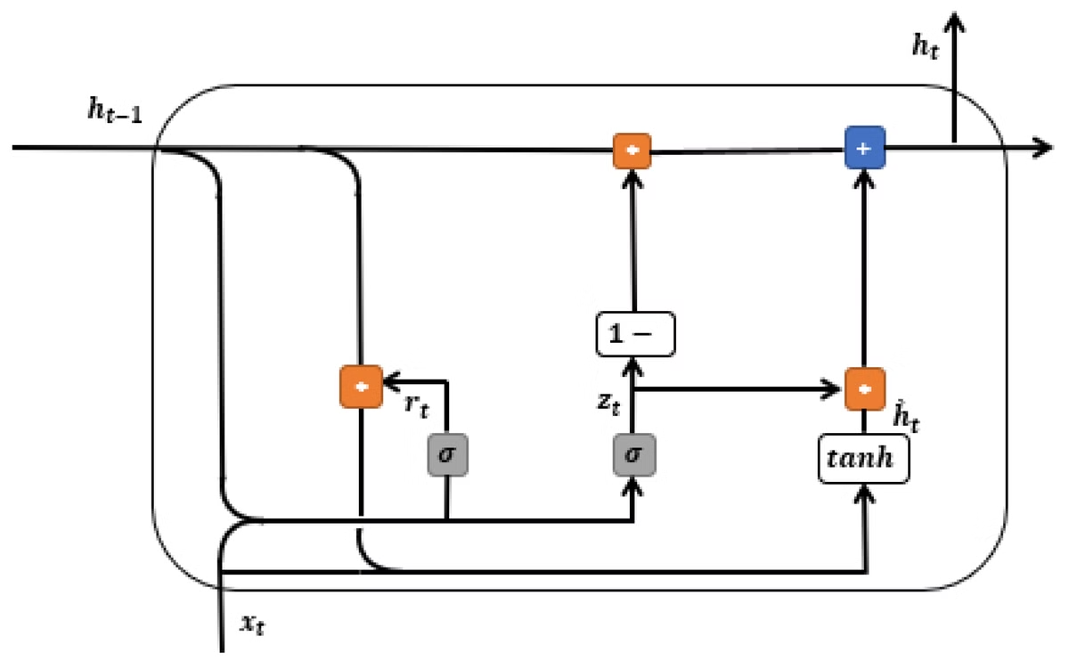
Gated Recurrent Unit (GRU)
Faster Training
Reduced Memory Consumption
Similar to LSTM but utilizes Gated Recurrent Units for faster training.
Reduces memory consumption while maintaining prediction accuracy.
Standard Evaluation
Evaluated using standard performance metrics.
The GRU model is implemented with a hidden size of 128 units and two GRU layers. We utilize a dropout rate of 0.2 to prevent overfitting in the GRU model training. Additionally, the model is trained using the Adam optimizer with a learning rate of 0.001 and a mean squared error loss function to improve convergence.

Slide 13
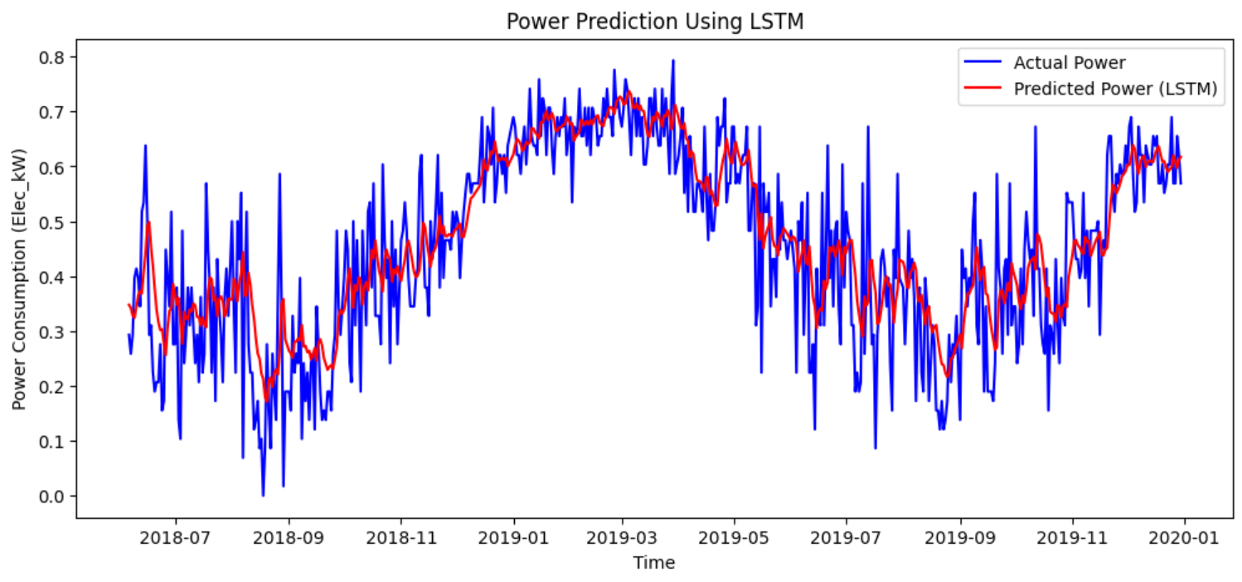
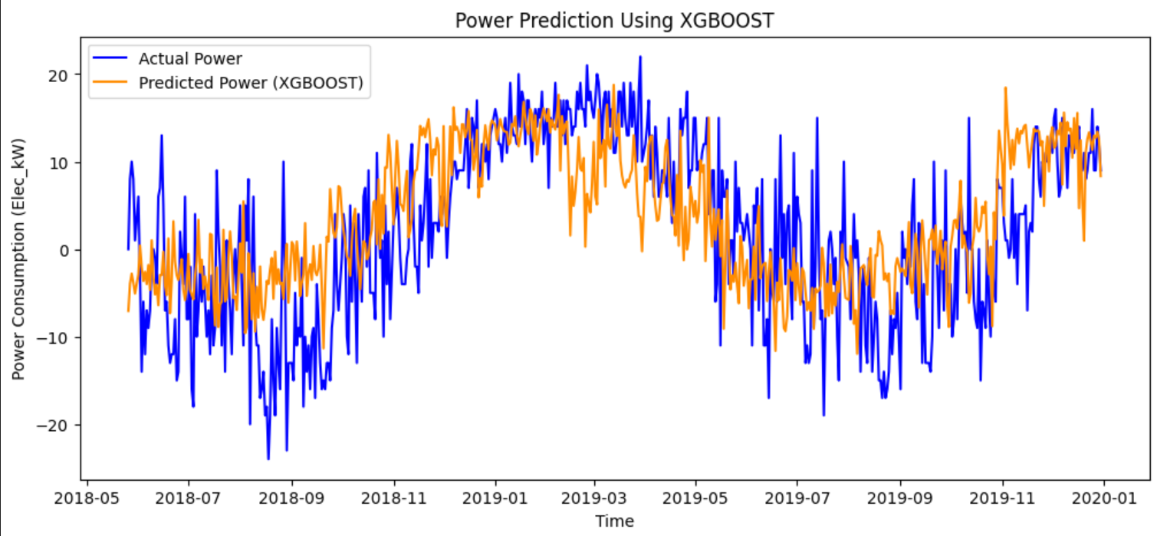
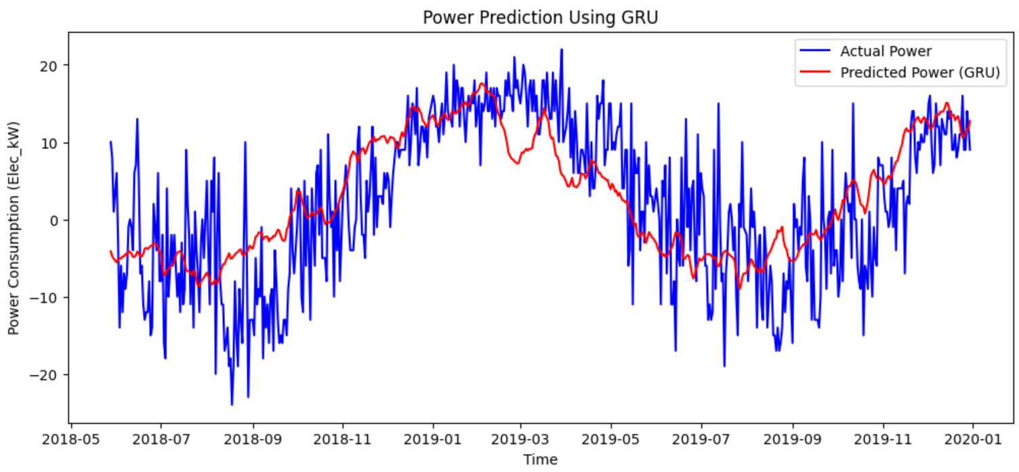
Experimental Setup and Results
We split data into 80% training and 20% test sets. XGBoost outperformed LSTM and GRU.

Slide 14
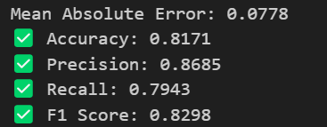
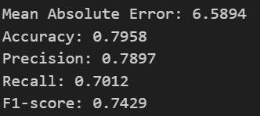
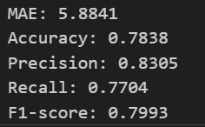
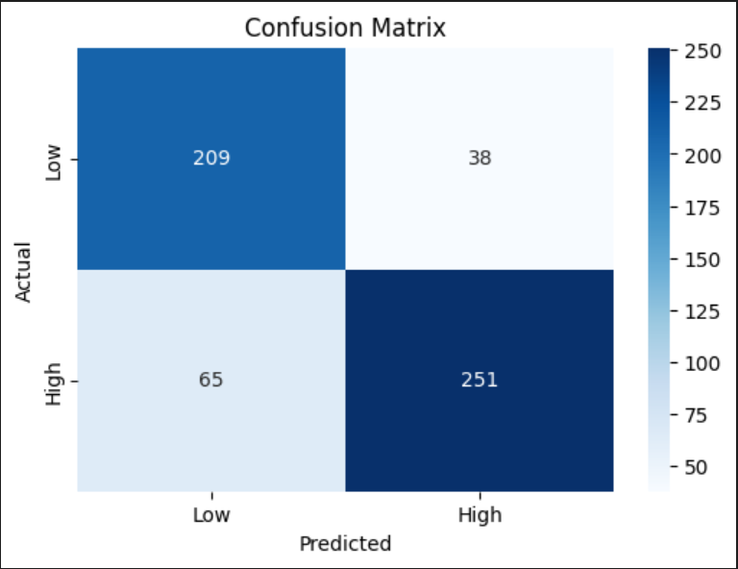
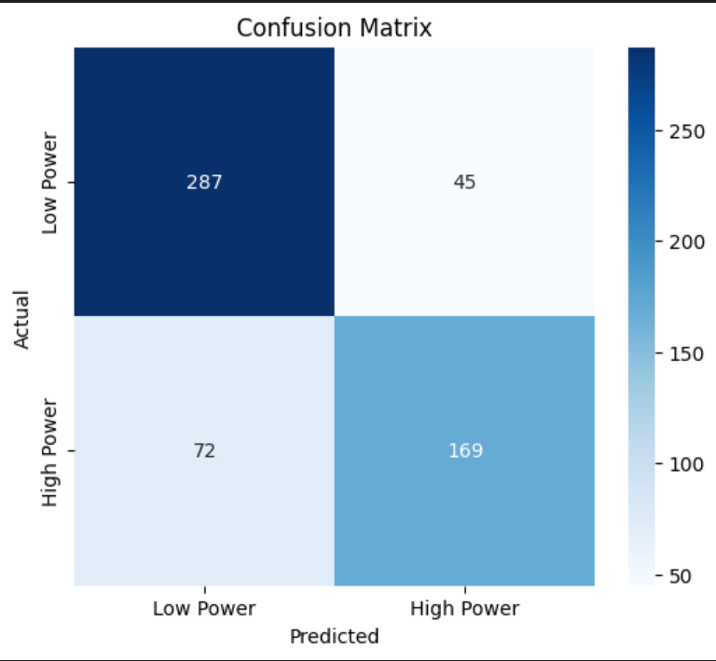
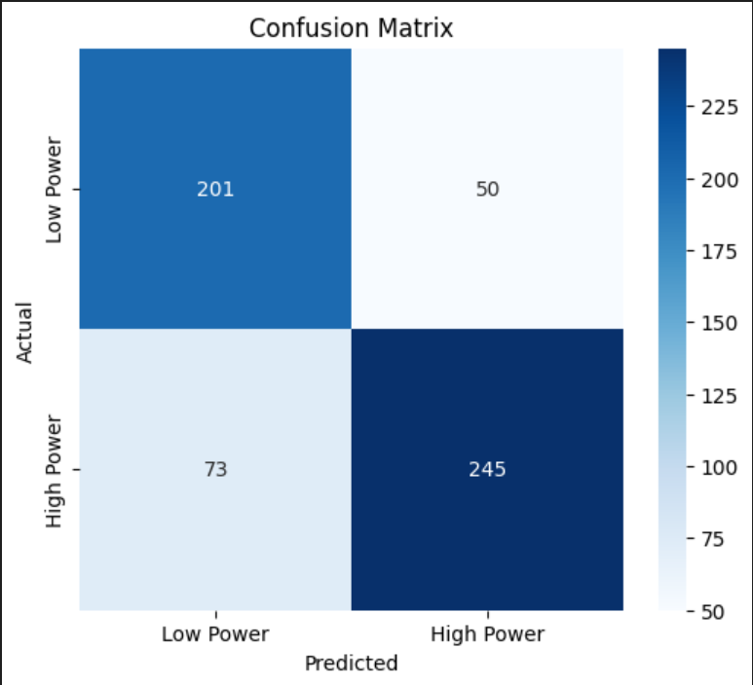
Metrics Results
I) LSTM
II) XGBOOST
III) GRU

Slide 15
Benefits and Impact
Grid Stability
1
Reduces renewable energy impact.
Efficiency
2
Optimizes systems, reduces waste.
Cost Savings
3
Lowers costs via better allocation.
We promote renewable energy adoption. Our models make it more reliable.

Slide 16




Future Scope: Advancing AI in Power Prediction
Incorporate real-time weather data from diverse sources. Develop hybrid AI models for combined strengths. Integrate AI with smart grid technologies. Focus on extreme weather event prediction. AI is the key to the future.
Real-Time Data
1
Hybrid Models
2
4
Extreme Events
3
Smart Grids

Slide 17



Conclusion and Future Directions
Advanced AI
1
Employ deep learning and neural networks for enhanced forecasting.
New Data
2
Integrate weather patterns, grid load, and historical data.
Robust Models
3
Develop adaptive models for diverse conditions and uncertainties.
AI improves renewable energy system management. Future steps involve advanced techniques, integrating diverse data sources, and building adaptive, robust models.

Slide 18

Thank You
Our work demonstrates the significant potential of AI in renewable energy. By integrating diverse data and advanced modeling, we can effectively manage the challenges and uncertainties inherent in these systems. Continued AI research promises further innovation and enhanced sustainability in the renewable energy sector.

